Slide 1

File IO - Reading Files
M1-D16
Participate! The more engagement the better! You are NEVER interrupting me!

Slide 2
Week 4 at a glance:
Monday: Exception Handling (No exercise!) Tuesday: File input / output (Exercise) Wednesday: In class assessment & review (No exercise)
Thursday: Capstone 1- Day1 (pair) Friday: Capstone 1 - Day 2 (pair)

Slide 3
Things you should know for the capstone
Maps / Lists / Arrays / Loops
Reading in user input using scanner
Reading in data from files / String functions like split
Writing out data to files
Creating classes / objects and calling objects and passing data back and forth between objects (using methods!), and constructors.
Calling methods, getting data back from methods, passing data to more methods, methods will lead to world peace…. Seriously, methods… Not a complete list but these are the big things…

Slide 4
Two Types Of Errors
A compile-time error occurs when there is a syntactical error or the compiler identifies code that it cannot parse or execute (e.g. method does not exist, accessibility not public, redefined constant, type mismatch)
A run-time error occurs while the program is executing. The program often tries to access memory that is inaccessible (out of bounds array or null object) or may be asked to perform an operation it is incapable of (e.g. access a restricted file, parse a value)

Slide 5
Exceptions
An exception is an unwanted or unexpected event, which occurs during the execution of a program. (NullPointerException, FileNotFoundException, etc)

Slide 6
Exceptions
Exception handling is the process of responding to exceptions thrown when the program has an exception.
We wrap a try/catch around code that has a likelihood or potential to have an exception condition. This allows us the ability to catch and handle an exception if it occurs. As the developer, we can choose to handle it at the point of exception or ‘throw’ it up the method stack for someone else to handle. Unhandled exceptions will crash your program.

Slide 7
Two Types of Exceptions
1) Checked: are exceptions that are known/checked at compile time. If a method you plan to call is known to have the possibility of throwing an exception (defined by the method), then the compiler will force you to handle the exception. These exceptions are nice because they give you a better opportunity to handle them gracefully because you know in advance ‘what type’ of exception could be thrown.
Ex: FileNotFoundException
2) Unchecked are exceptions that are not checked at compile time. This type of exception can occur unexpectedly and be hard to know in advance. Unchecked exceptions are often caused by poor coding practices or poor testing.
Ex: IndexOutOfBoundsException

Slide 8
Simple Try/Catch (with exception - line 2)
try {
// Block of code to try
1.
2.
3.
}
catch(Exception e) { 4.
// Block of code to handle errors 5. e.printStackTrace();
}
6. Account acc = new Account();
If exception occurs on line 2. Line 3 is skipped and catch block is called. Information about the Exception is in the Exception object e
After the catch block, program resumes on line 6
printStackTrace() method logs to console

Slide 9
Simple Try/Catch - (no exception - Happy Case)
try {
// Block of code to try
1.
2.
3.
}
catch(Exception e) { 4.
// Block of code to handle errors 5. e.printStackTrace();
}
6. Account acc = new Account();
If no exception occurs, lines 1-3 will execute as normal. Since there is no exception, the catch block is skipped and the program resumes on line 6

Slide 10
Simple Try/Catch (with exception - line 1)
try {
// Block of code to try
1.
2.
3.
}
catch(Exception e) { 4.
// Block of code to handle errors 5. e.printStackTrace();
}
6. Account acc = new Account();
If exception occurs on line 1. Lines 2-3 are skipped and catch block is called. Information about the Exception is in the Exception object e
After the catch block, program resumes on line 6

Slide 11
Try/Catch/Finally (with exception)
try {
// Block of code to try
1.
2.
3.
}
catch(Exception e) { 4.
// Block of code to handle errors 5. e.printStackTrace();
} finally { // do something }
6. Account acc = new Account();
If exception occurs on line 2. Line 3 is skipped and catch block is called. Information about the Exception is in the Exception object e
After the catch block, finally block is executed.
The finally statement lets you execute code, after try...catch, regardless of the result

Slide 12
Try/Catch/Finally (No Exception)
try {
// Block of code to try
1.
2.
3.
}
catch(Exception e) { 4.
// Block of code to handle errors 5. e.printStackTrace();
} finally { // do something }
6. Account acc = new Account();
If no exception occurs, lines 1-3 will execute as normally. Catch block is bypassed since there is no exceptions. Finally block will execute.
The finally statement lets you execute code, after try...catch, regardless of the result

Slide 13
Multiple Catch Blocks
try {
// Protected code
} catch (FileNotFoundException e1) {
// Catch block
} catch (DataAccessException e2) {
// Catch block
} catch (Exception e3) {
// Catch block
}
6. Account acc = new Account();
A try block can be followed by multiple catch blocks. If an exception is thrown, the first block will check for a match. If not found, it will check the second. If not found, it will check the third, and so on...
Must go from most specific to generalized as you go down, otherwise the generalized one will pick it up first.

Slide 14
Throws
try {
doSomethingDangerous(); // throws an ArrayIndexOutOfBoundsException
} catch(ArrayIndexOutOfBoundsException e) {
System.out.println(“Oh no!”)
}
This code calls the method below. This code ‘catches’ and exceptions thrown by the method
private void doSomethingDangerous() throws ArrayIndexOutOfBoundsException {
int[] numbers = new int[5];
for(int i = 0; i < 10; i++) {
numbers[i] = i; // this line will throw an Exception once i reaches 5
}
}
Instead of catching it here… We can throw the exception up to any callers of the method
This approach allows you to bubble up exceptions to calling methods, or even eventually out to your main program loop. This will also allow you to create a checked exception.

Slide 15
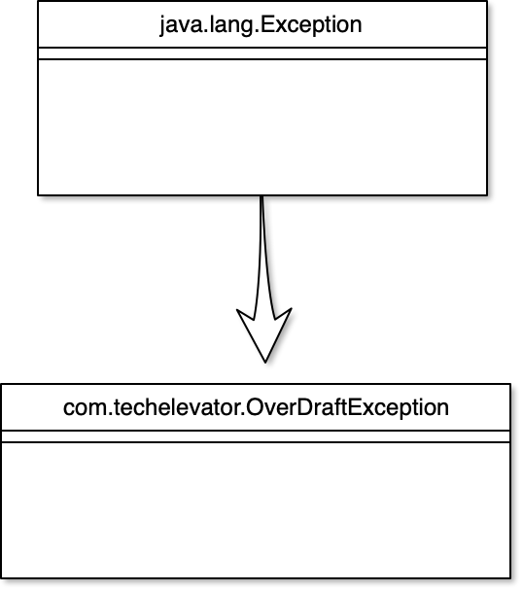
Exception class
All exception classes are subtypes of the java.lang.Exception class
This means we can extend it to create our own custom exception types or use others like:
ArithmeticException
ArrayIndexOutOfBoundsException
ClassNotFoundException
FileNotFoundException
IOException
NullPointerException
NumberFormatException
StringIndexOutOfBoundsException

